Slide 1



Cliftonville Primary and Pre-School Wellbeing
Award Verification

Slide 2
Cliftonville Primary and Pre-School Wellbeing
Our Vision
Wellbeing is at the core of what we do everyday and this is reflected in our school values as the centre to all we do at Cliftonville Primary and Pre-school. We commit to making it our mission to promote positive wellbeing for all our pupils, staff and the wider community including parents and carers. We recognise that without positive wellbeing we cannot reach our full potential. Therefore, we aim to educate and support our whole school community on the importance of wellbeing and mental health, ensuring it is everyone’s responsibility to care for one another. Through our innovative ‘Wellbeing Hub’ we will provide mental health support, understanding and intervention for pupils and parents ensuring a holistic approach. Our staff are our greatest resource and so we ensure that all staff have a supportive network and feel they are listened, to and valued at all times.

Slide 3
Cliftonville Primary and Pre-School Wellbeing
How we addressed objective 1
We are committed to promoting emotional and mental health and wellbeing. Cliftonville Primary and Pre-school has a diverse Wellbeing team, responsible for promoting the wellbeing and positive mental health of pupils, staff, families and the wider community. We employ a SLT lead with responsibility for Wellbeing and are committed to securing the Wellbeing award.
Set up a change team including a variety of stakeholders.
Considered the result of evaluations and how improvements can be made for staff, pupils and parents.
Produced an action plan which has been shared with the leadership team
Announced the Award at staff meetings, discussed at staff weekly morning briefings, sent out Wellbeing newsletter detailing new actions termly
Written to all families outlining the award, reminded in newsletters and social media site.
Conducted surveys
Engaged with pupils through Wellbeing ambassadors and class discussions

Slide 4
Cliftonville Primary and Pre-School Wellbeing
How we addressed objective 2
The school has a clear vision and strategy for promoting and protecting emotional wellbeing and mental health, which is communicated to all involved with the school.
Wellbeing a key area on school development plan for last two years and plans for the next three years across pupils, staff, families and wider community led by member of SLT and the pastoral team.
Ensure Safeguarding and up to date mental health and wellbeing are both reflected in on-going training and to ensure risk factors are central to action planning. All relevant policies updated with Mental health and Wellbeing areas identified.
Wellbeing Strategic document created and incorporated into 3 year school strategic plan.
Improved staff spaces for wellbeing have been part of budget for last
and this year.

Slide 5
Cliftonville Primary and Pre-School Wellbeing
How we addressed objective 3
The school has a positive culture which regards emotional wellbeing and mental health as the responsibility of all.
Accountability framework created shared with staff and on School website
Governors and newly formed PTA seen strategic plan and have plans on how to support us s a school in the coming year.

Slide 6





Cliftonville Primary and Pre-School Wellbeing
How we addressed objective 3
Pupil Wellbeing ambassadors set up and led by a member of the Change Team. Meeting weekly to discuss school wide issues and to liaise with their classes.

Slide 7
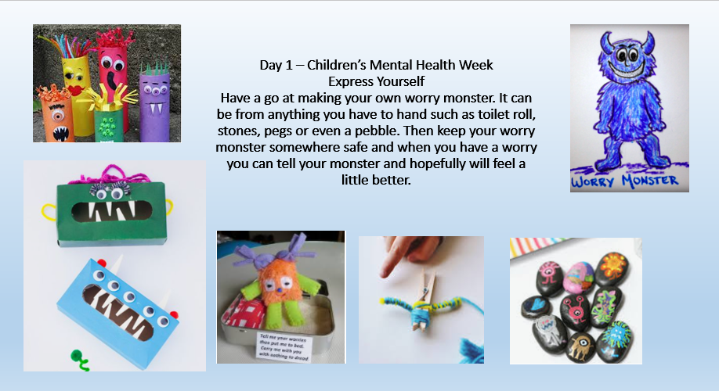

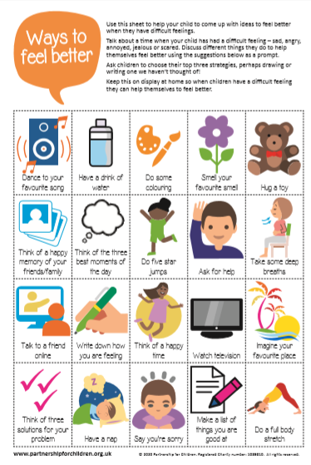

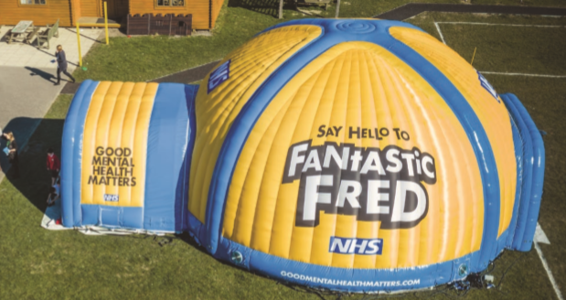
Cliftonville Primary and Pre-School Wellbeing
How we addressed objective 3
Children’s mental health week
Cancelled twice due to Covid but booked again for Autumn term!
Regular Wellbeing
Assemblies

Slide 8
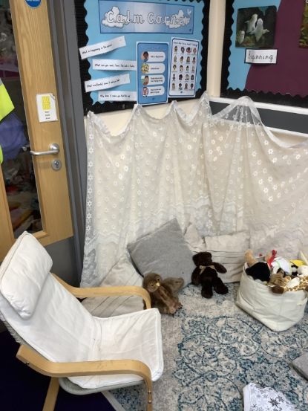
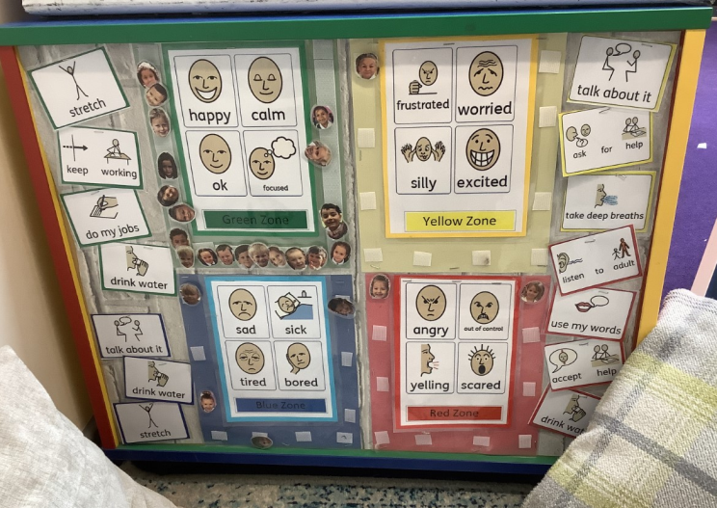
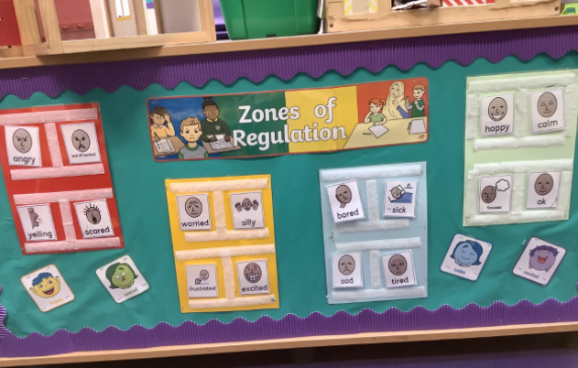
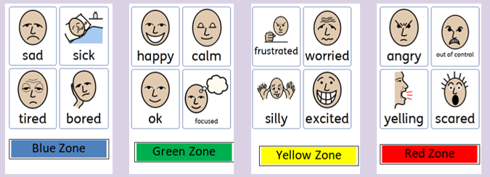
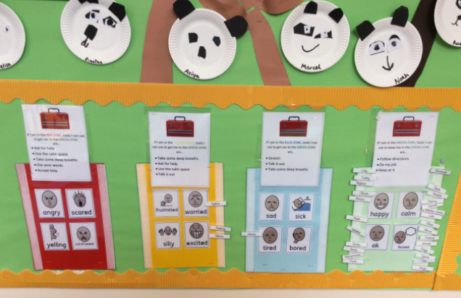
Cliftonville Primary and Pre-School Wellbeing
How we addressed objective 3
Zones of Regulation
3.1 – Each class has their version of Zones of Regulation for children to show how they are feeling and for staff to be able to support them. PHSE lessons and Wellbeing lessons re cap on the emotions regularly along with termly assemblies.

Slide 9

Cliftonville Primary and Pre-School Wellbeing
How we addressed objective 4
The school actively promotes staff emotional wellbeing and mental health
Staff Wellbeing identified if mental health and wellbeing policy.
School Leadership structure ensures there is line managers always on hand to support staff.
Performance Management Review refers to importance of staff wellbeing
Counselling available on request – plans for CAT wide access to Health and Wellbeing subscription for access to further mental health support.
Staff aware of costs incurred by the school to support wellbeing
Wellbeing Team meet termly to discuss issues in their year groups.
Bi weekly Staff Wellbeing newsletter featuring fun recommendations, Wellbeing links, Recipes and Staff news.
Virtual Quiz night
Bespoke step by step cooking videos and recipe cards

Slide 10
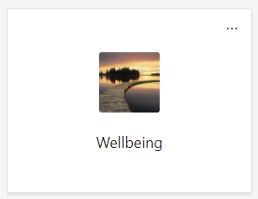
Cliftonville Primary and Pre-School Wellbeing
How we addressed objective 5
The school prioritises professional learning and staff development on emotional wellbeing and mental health.
Bespoke training by in house Play therapist on Neuroscience and behaviour focusing on trauma related strategies delivered to all staff in 2020. As recorded training can continue to share with new staff in coming year.
Lockdowns or isolations used effectively by staff to access a wide range of Mental Health training. CPD file tracks progress of all staff and their access to training.
Webinars by Thanet inclusion services accessed by all TA’s in term 6 2020 during staff meeting time
TEAMs area set up with access to all training links, and useful resources for staff to access.

Slide 11

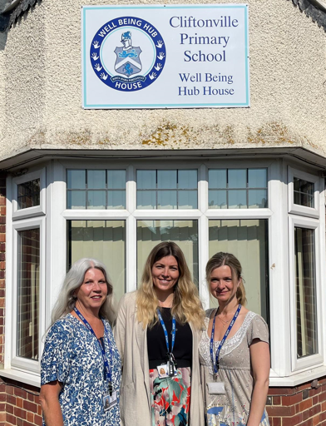
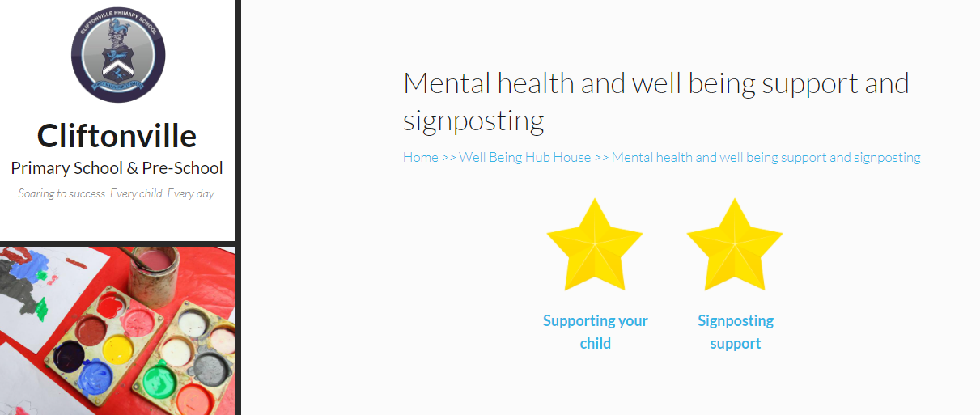
Cliftonville Primary and Pre-School Wellbeing
How we addressed objective 6
The school understands the different types of emotional and mental health needs across the school and has systems in place to respond appropriately.
Wellbeing Hub House a unique and vital resources that houses our Pastoral Team and Play therapists that support Pupils on a daily basis along with Parents and the wider community. Termly PPI meetings also identify children of concern and support to be put in place.
Pastoral TEAMs area set up to ensure ease of communication and sharing off information.
Pastoral / DSL / SEND teams meet weekly to discuss children / parents of concern and actions identified to support them going forward.
Training delivered in last year ensures staff can identify Mental health concerns and can notify a Pastoral Team member to support children.
Website has links to Mental health support and signposting links.

Slide 12
Cliftonville Primary and Pre-School Wellbeing
How we addressed objective 6
The school understands the different types of emotional and mental health needs across the school and has systems in place to respond appropriately.
Bespoke Emotional Support programme has been written by Play therapist to address areas of Emotional distress such as Separation anxiety, phobias and fears. Initial assessment identifies which anxieties the child has and identifies the packages needed to work through. Run in all Year groups by TA’s.
Children with higher levels of Trauma have access to a Play therapist.
LAC children given priority slots using PP+ funding for play therapy.

Slide 13
Cliftonville Primary and Pre-School Wellbeing
How we addressed objective 7
The school actively seeks the ongoing participation of the whole-school community in its approach to emotional wellbeing and mental health.
Termly Parent Forum meetings
Newly formed PTA as a result of requests from parents to be able to support the school further.
Parent Surveys
Pupil surveys
Staff surveys
Suggestion Boxes put in all area of the school monitored and responded to by SLT Wellbeing Lead.
Face book page sharing mental health, Wellbeing links, community projects and events.
Virtual Coffee morning

Slide 14



How we addressed objective 7

Slide 15














Cliftonville Primary and Pre-School Wellbeing
Wellbeing Hub House team has developed a wide range of partners over the last two years that has helped us serve our parents and the wider community in a time when it was needed the very most.
Our Partnerships

Slide 16


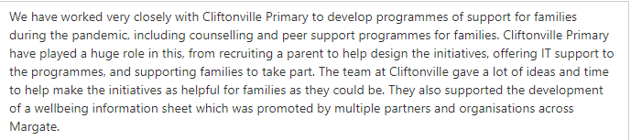

Cliftonville Primary and Pre-School Wellbeing

