Slide 1



Year 1 Phonics Screening Check
Information Meeting
Welcome

Slide 2
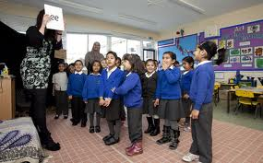

All about phonics…..
Children have two phonics lessons every day
Children are taught to read by breaking down words into separate sounds or ‘phonemes’. They are then taught how to blend these sounds together to read the whole word.
There are around 40 different sounds.

Slide 3
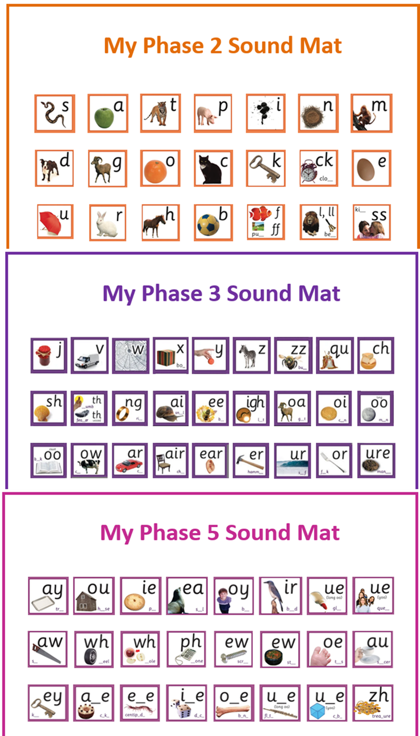

Slide 4

What is the Phonics Screening Check?
It was introduced by the government in 2012 and is a statutory assessment for Year 1 children across schools in England.
It is designed to show how well your child can use the phonics skills they have learned and to identify those who may need extra help with phonics.
It assesses whether your child is able to read words at the appropriate Year 1 standard.

Slide 5
What is the Phonics Screening Check?
Year 1 children across the country will be completing the Phonics Screening Check.
The focus of the check is to provide evidence of children’s decoding and blending skills, not to test their vocabulary or their comprehension.
This year it takes place from 10th – 14th June.
The check is very similar to tasks the
children already complete during phonics lessons.
Designed so that children of all levels can take part.

Slide 6

What will the children do?
The check consists of reading 40 words
They will read with a familiar adult
The children will be asked to draw on sound buttons, sound out the word and then blend the sounds together to read it
k i ck kick
It will assess 20 real words and 20 nonsense words
Children will know if the word is real or nonsense because nonsense words have an alien next to them

Slide 7

Nonsense (alien) words
Nonsense or ‘alien’ words don’t mean anything. They check whether your child can apply their knowledge of phonics to read unfamiliar words. They are included because they will be new to all children; they do not favour children with good vocabulary knowledge or visual memory of words.

Slide 8
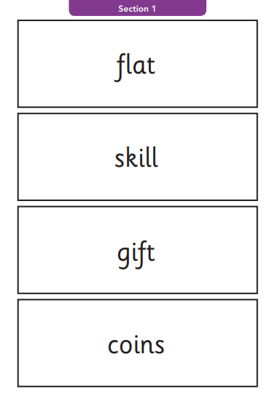
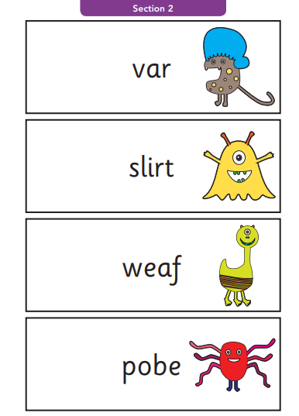
Examples of words

Slide 9
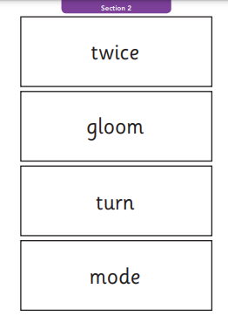
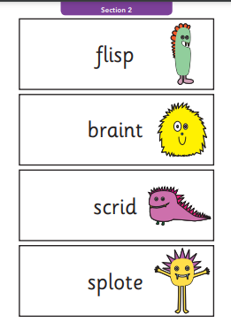
Examples of words

Slide 10
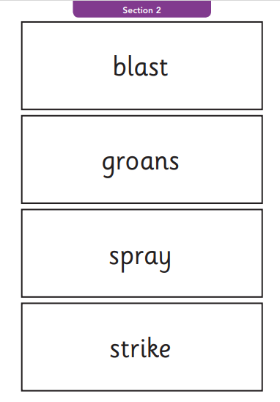
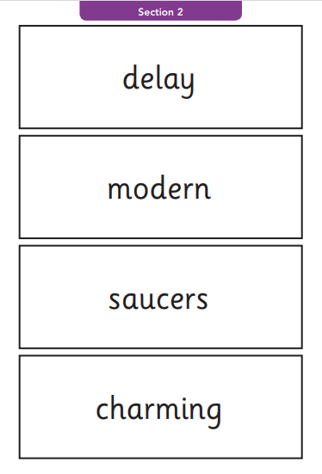
Examples of words

Slide 11
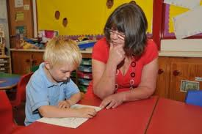
How will it be administered?
One to one in a quiet area of the school
With an adult they know
Your children are very familiar with the process
We are not allowed to indicate to the children at the time whether they have read the word correctly

Slide 12

And the results…..?
Children will be scored against a national standard (historically the threshold has been 32/40)
We will inform you of whether they fall below or within this standard on their school report.
If your child’s score falls below the national standard they will be required to re-take the Phonics Screening Check in Year 2.

Slide 13
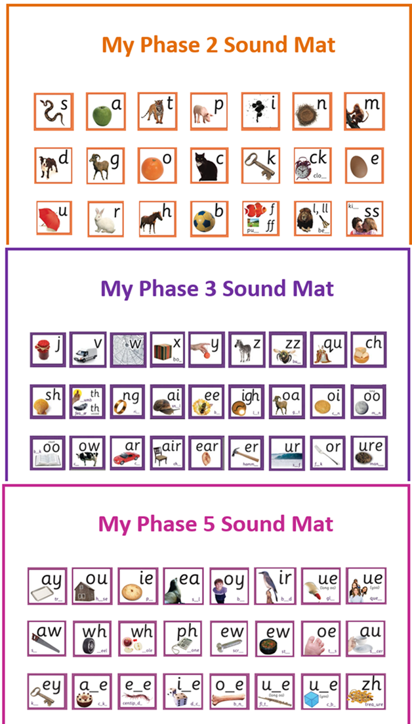
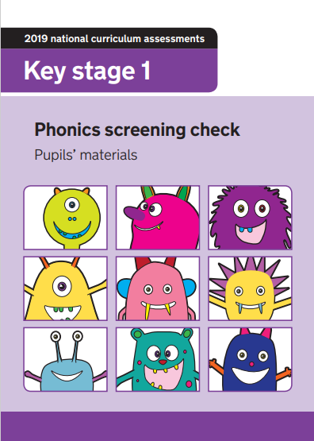

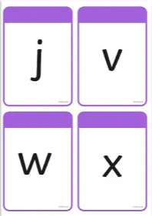
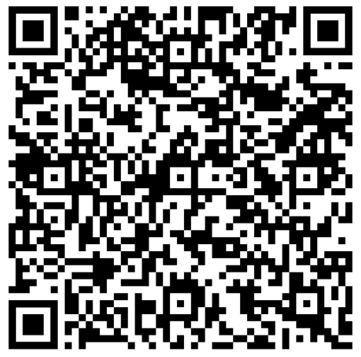
How can I help my child prepare?

Slide 14
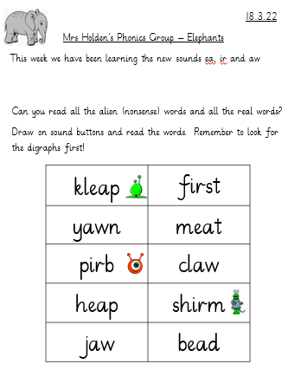
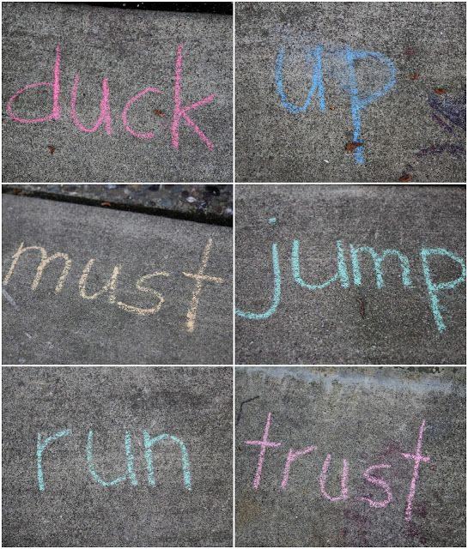

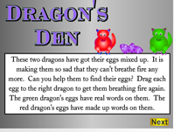

How can I help my child prepare?
www.phonicsplay.co.uk
Username: cliftonville
Password: Cliftonville2021

Slide 15
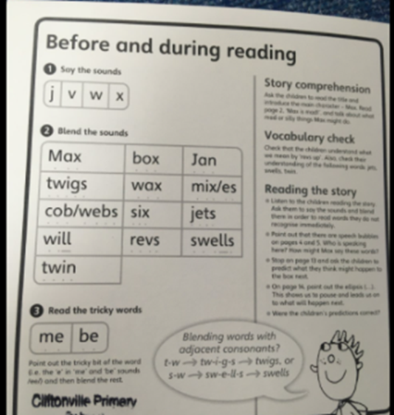
How can I help my child prepare?
Regular reading at home at least 3 times a week will help massively.
Sounds they are learning
Words to practise before reading
Remember: the books are matched to your child’s phonic knowledge so they are able to read them. If they are stuck, please remind them to break the word down into its sounds and blend them like they do at school as well as taking clues from the picture and sentence.

Slide 16
Questions…..?

