Slide 1

Year 6 2026-2027

Slide 2
Meet the team!

Slide 3
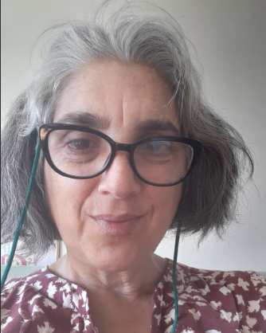



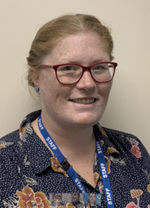

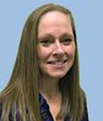
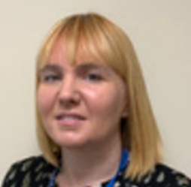

6B
6H
Miss Brown
Mr Pringle
Phase Leader
Mrs Hawkins
6Ke
6Ki
Mrs Keeley
Mrs Mills
HLTA
Mr Kirby
Year 6 TAs
Mrs Hammond
Y5/6 TA
Mrs George
TA
Ms Rydz
TA

Slide 4
If you need to contact me
Email address:
year6leader@cliftonvilleprimary.co.uk

Slide 5
To and from school

Slide 6


Times of the day
Entrance and exit is via gate in the car park (where you currently pick your children up)
Start of Day: 8:30 (Late from 8:40)
Play: 10:30-10:45
Lunch (eat): 12:15-12:40
Lunch (play): 12:40-1:10
End of Day: 3:00 (Child will be taken to office at 3:10)

Slide 7


Walking home
We know that you may have already given permission for your child to walk home unaccompanied.
However, please do fill in the form (that will be sent out) again so that the new teachers are very clear on this.
The days get darker in September – so do think about permission for walking home after clubs.

Slide 8
OPAL Play & UNIFORM

Slide 9
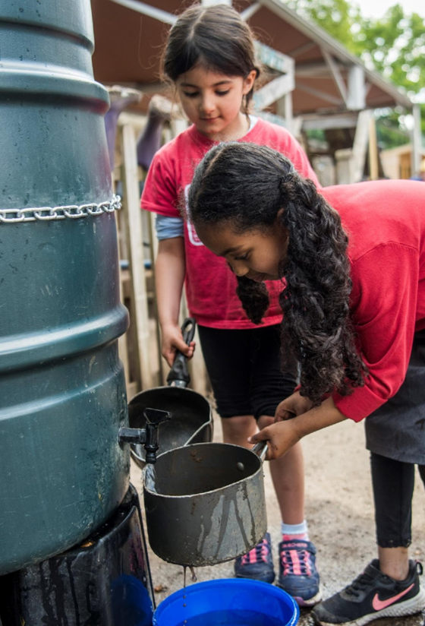
OPAL Play
We are excited to be starting our OPAL journey in September.
Children's playtimes will begin to look quite different with a much more hands on approach with lots of exciting equipment for imaginative play.
There will be sandpits, digging, den building, small world, scooters, climbing and much more!
We will be keeping you updated on our progress and sending out requests for donations of things you may have at home to help develop each new area such as mud kitchen equipment, small world items, cardboard boxes, grown out of scooters etc
Children will have more opportunity to play together across the school and explore new areas as we develop them across next year.

Slide 10
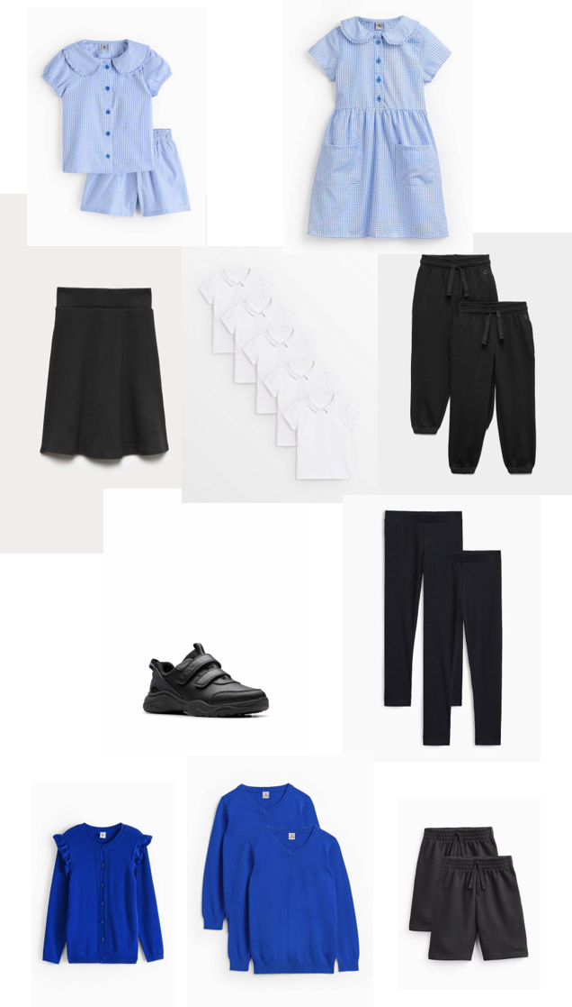
Active uniform
As we are moving to OPAL and much more interactive outdoor play, we have made the decision to move to an 'Active uniform'
This really just means that it will be PE uniform every day, which allows children to move more freely and save parents money on buying two uniforms.
The uniform will consist of:
  Plain black joggers, leggings, jersey trousers, or shorts
  Plain white polo shirt
  Plain blue school jumper or cardigan (with or without logo)
  Black trainers
Optional items:
  Black skort (skirt with shorts built in)
  Blue gingham shorts and top (summer)
  Blue summer dress with shorts underneath (summer)
There will be a transition period to allow clothes to be used that children have not grown out of yet. However, as uniform is replaced it is the expectation that active uniform will be used. No branded items or coloured trainers will be excepted.

Slide 11
Wider curriculum

Slide 12


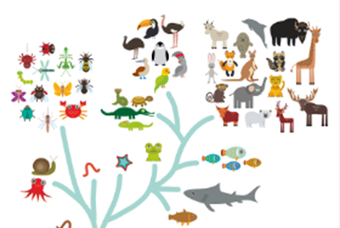

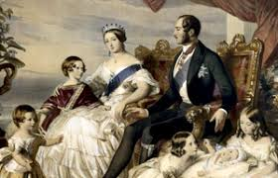

Science – earth and space
Science – forces
Science – living things
History – the Victorians
Geography – the Americas
History – Ancient Greece

Slide 13
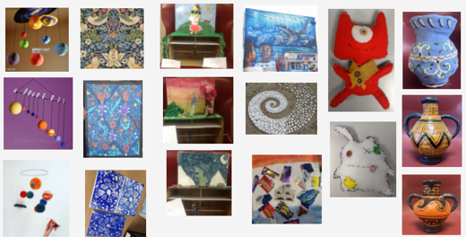
Fantastic and fun learning!

Slide 14
PSHE
There is an emphasis on social media use in Year 6 – many of the issues that blow up across the year group stem from use of social media.
Emotions often run high in Year 6, and friendship groups can change. We talk about navigating conflict.
This includes personal hygiene etc but also emotional health and aspects of body image and the media etc. It is not sex education.
What healthy relationships look like. Understanding different family set-ups and fostering acceptance and understanding.

Slide 15

We will need to work together as parents, carers and educators in order to get our children ready for Year 7.
Right now, this might be rather panic-inducing for you, but I guarantee that they will be ready by this time next year. They always are.
RESILIENCE
is a key skill that our children will need to adopt.
There are more tests in Year 6. This is so we can identify any gaps in their understanding and move their learning forward at an accelerated pace.
We will encourage them to think positively around this and urge you to do the same.
It is so important that they have the best chance of succeeding in secondary school.
If we are doing our job right, sometimes the things that we guide your children towards may seem hard at first. That’s where true learning lies.

Slide 16
Send:
Special educational needs & disability

Slide 17
If you have an initial concern about your child’s progress, behaviour or provision:
Speak to the class teacher
Speak to the phase leader
Speak to the assistant sendco (on the ks2 playground at the start of the day
If your child is already within the sen system, it may be appropriate to contact the sendco directly:
Email: senco@cliftonvilleprimary.co.uk
01843 227575

Slide 18
home learning

Slide 19




Reading 4 pleasure accelerated reading
Please try to ensure that your child reads every day – it is so important to their development!

Slide 20
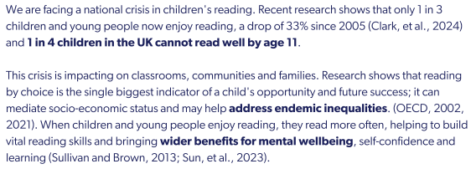
Reading 4 pleasure accelerated reading
Please try to ensure that your child reads every day – it is so important to their development!

Slide 21
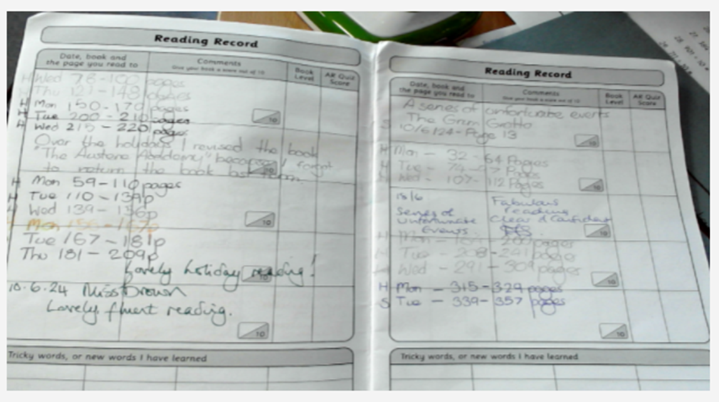
Reading Records
This is a lovely example of a filled-in reading record. The child has written the date that they read and the page number that they got up to. They’ve also written H or S to show if they have read at home or school. Please encourage your child to do the same. Please remember to sign the entry when they have read. Whilst there is no requirement to read to an adult, it can be a rewarding experience occasionally.

Slide 22

FREE Summer Reading Challenge
This year’s Challenge is Read to the Beat!, delivered by The Reading Agency in partnership with public libraries and powered by Universal Music Group UK. The theme inspires children to explore the connection between stories and songs, discovering how reading and music both ignite imagination and creativity.
Children sign up through their local library. They borrow and read books of their choice during the summer, collecting special stickers and rewards along the way. Library staff and volunteers help children to discover new books that suit their interests and reading level and run a programme of free themed activities in the library.
Children can take part online, too! www.summerreadingchallenge.org.uk
The Challenge has already started in Kent libraries.
Head to your local library this summer and sign up!

Slide 23


maths

Slide 24


spellings
Each child will have a purple spelling journal
Weekly spelling list stuck in (not handwritten out by children in case of errors)
Children can practise the spellings/focus rule at home using a variety of strategies
Maximum of 2 double page spreads per week
Journal goes home every night and back to school the next morning just like their reading record
Back of book is personal spelling log – child records their score on the test and writes down the words that were spelt incorrectly to keep practising further

Slide 25
Any questions?

