Slide 1

Year 5 2026-2027

Slide 2
Meet the team!

Slide 3



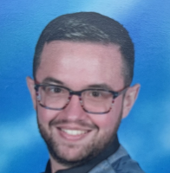
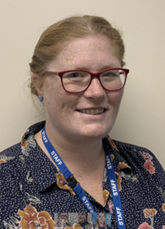
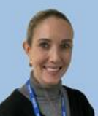
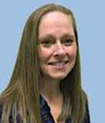
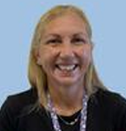
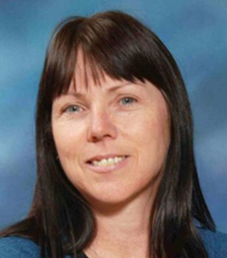
5A
5D
Miss Amato
Mr Pringle
Phase Leader
Mr Dyett
5N
5T
Mr Neve
Mrs Mills
HLTA
Miss Taylor
Year 5 TAs
Mrs Hammond
Y5/6 TA
Miss Dale
TA
Mrs Williams
TA

Slide 4
If you need to contact me
Email address:
year5leader@cliftonvilleprimary.co.uk

Slide 5
To and from school

Slide 6


Times of the day
Entrance and exit is via gate in the car park (where you currently pick your children up)
Start of Day: 8:30 (late from 8:40)
Play: 10:30-10:45
Lunch (eat): 12:00-12:25
Lunch (play): 12:25-12:55
End of Day: 3:00 (child will be taken to office at 3:10)

Slide 7


Walking home
In Year 5, children are allowed to walk home unaccompanied ONLY if we have permission from you.
If you would like this to happen at any point in the year, please let the office know and they will pass that information on to teachers.
We will need separate permission if this also applies to after-school clubs.
Please bear in mind, it gets dark very early in the winter months – this might be something you’d like to consider later on in the year.

Slide 8
OPAL Play & UNIFORM

Slide 9
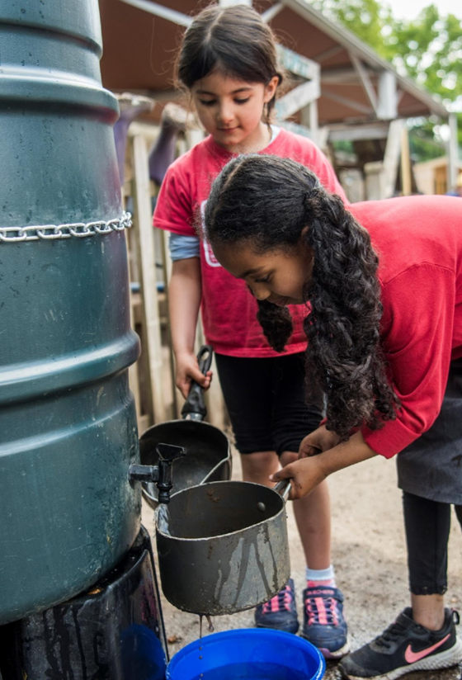
OPAL Play
We are excited to be starting our OPAL journey in September.
Children's playtimes will begin to look quite different with a much more hands on approach with lots of exciting equipment for imaginative play.
There will be sandpits, digging, den building, small world, scooters, climbing and much more!
We will be keeping you updated on our progress and sending out requests for donations of things you may have at home to help develop each new area such as mud kitchen equipment, small world items, cardboard boxes, grown out of scooters etc
Children will have more opportunity to play together across the school and explore new areas as we develop them across next year.

Slide 10
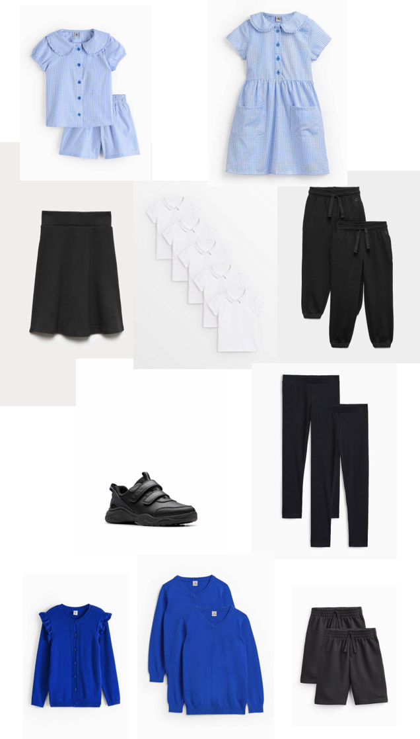
Active uniform
As we are moving to OPAL and much more interactive outdoor play, we have made the decision to move to an 'Active uniform'
This really just means that it will be PE uniform every day, which allows children to move more freely and save parents money on buying two uniforms.
The uniform will consist of:
  Plain black joggers, leggings, jersey trousers, or shorts
  Plain white polo shirt
  Plain blue school jumper or cardigan (with or without logo)
  Black trainers
Optional items:
  Black skort (skirt with shorts built in)
  Blue gingham shorts and top (summer)
  Blue summer dress with shorts underneath (summer)
There will be a transition period to allow clothes to be used that children have not grown out of yet. However, as uniform is replaced it is the expectation that active uniform will be used. No branded items or coloured trainers will be excepted.

Slide 11
Wider curriculum

Slide 12
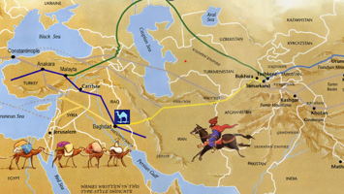


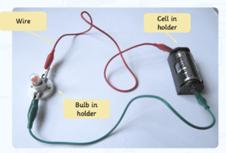
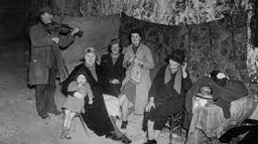
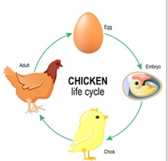
History – Early Islamic empire: what did they achieve?
Science – states of matter
Geography - italy
Science – electricity and light
History/geography – WWII: life in thanet
Science – lifecycles, ageing and healthy living

Slide 13
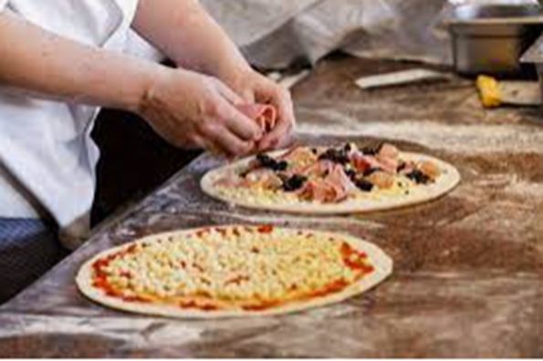

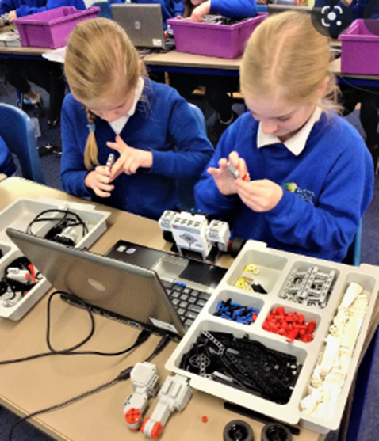
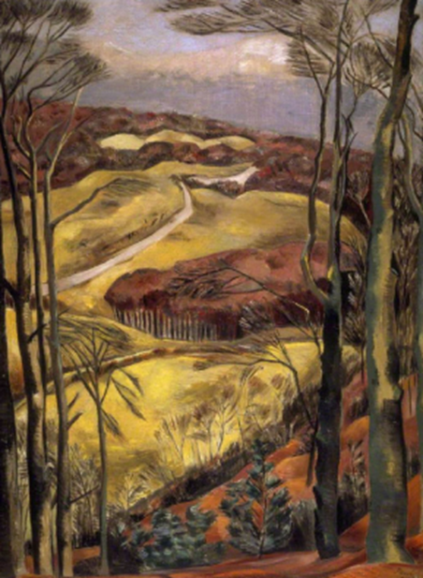
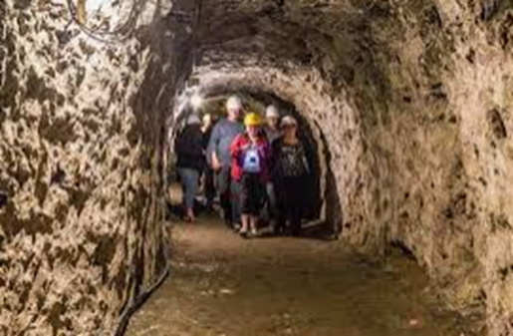
Fantastic and fun learning!

Slide 14
Send:
Special educational needs & disability

Slide 15
If you have an initial concern about your child’s progress, behaviour or provision:
Speak to the class teacher
Speak to the phase leader
Speak to the assistant sendco (on the ks2 playground at the start of the day
If your child is already within the sen system, it may be appropriate to contact the sendco directly:
Email: senco@cliftonvilleprimary.co.uk
01843 227575

Slide 16
home learning

Slide 17




Reading 4 pleasure accelerated reading
Please try to ensure that your child reads every day – it is so important to their development!

Slide 18

Reading 4 pleasure accelerated reading
Please try to ensure that your child reads every day – it is so important to their development!

Slide 19

FREE Summer Reading Challenge
This year’s Challenge is Read to the Beat!, delivered by The Reading Agency in partnership with public libraries and powered by Universal Music Group UK. The theme inspires children to explore the connection between stories and songs, discovering how reading and music both ignite imagination and creativity.
Children sign up through their local library. They borrow and read books of their choice during the summer, collecting special stickers and rewards along the way. Library staff and volunteers help children to discover new books that suit their interests and reading level and run a programme of free themed activities in the library.
Children can take part online, too! www.summerreadingchallenge.org.uk
The Challenge has already started in Kent libraries.
Head to your local library this summer and sign up!

Slide 20


maths

Slide 21


spellings
Each child will have a purple spelling journal
Weekly spelling list stuck in (not handwritten out by children in case of errors)
Children can practise the spellings/focus rule at home using a variety of strategies
Maximum of 2 double page spreads per week
Journal goes home every night and back to school the next morning just like their reading record
Back of book is personal spelling log – child records their score on the test and writes down the words that were spelt incorrectly to keep practising further

Slide 22
Any questions?

