Slide 1

Preparing the children for Year 3.
Key Stage 1 = Years 1 and 2
Key Stage 2 = Years 3, 4, 5 and 6

Slide 2
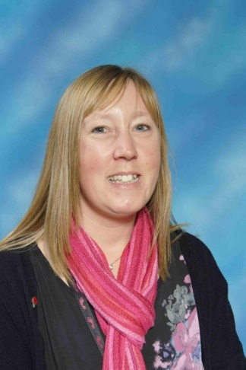
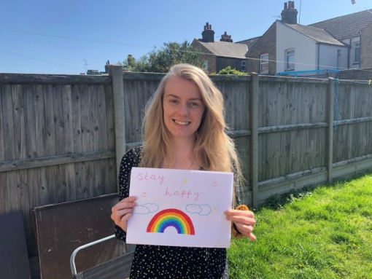

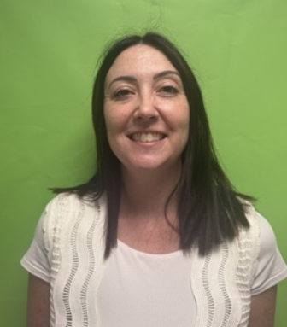
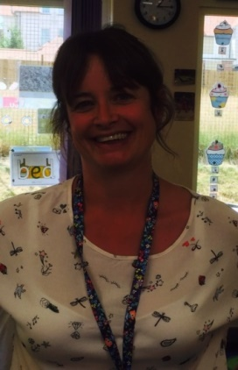
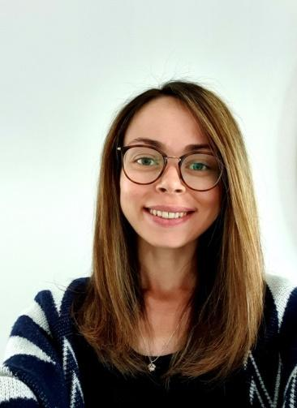
Teaching Assistant Miss Lane
Miss Kettyles 3K
Mrs Jewell 3W
Mrs Pender
Lower Key Stage 2 Phase Leader
Mrs Meades & Miss Wass 3J
Mrs Andrews 3B
Teaching Assistant
Mrs Palmer

Slide 3


Preparation behind the scenes for transition.
Teachers meet to discuss each child
TAs meet to discuss children
Phase leaders meet to share information
Children meet teachers for three sessions
Teachers and TAs pop in classes

Slide 4

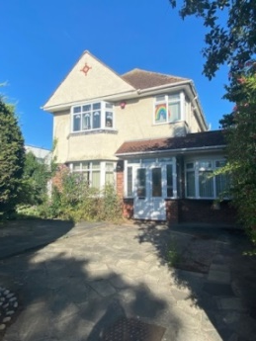
The start of the day.
8.35 – 8.45

Slide 5

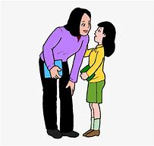

Morning Playtime
10.15 – 10.30
Key Stage 2 playground
Encourage your child to speak to an adult during playtime if they can not resolve disagreements themselves.
Children can bring piece of fruit to eat during morning play if they wish.

Slide 6
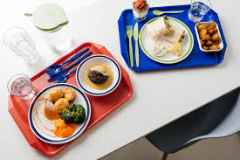
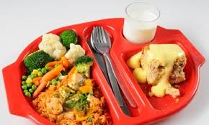
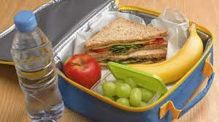
Lunch
12.00- 12.50
Eat lunch in Courage Hall 12.00 until 12.25 and then play on Key Stage 2 playground until 12.50.
Children no longer receive free school meals and need to pay, unless families are eligible. See the office if you are unsure.

Slide 7


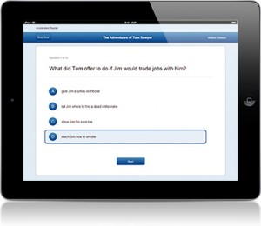
Reading books
Children read their books and complete comprehension quizzes in school on a Chromebook.
ZPD
1.7 – 2.7
Children are expected to read at least three times a week. Please write a quick note in their reading record book.

Slide 8


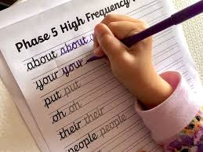
Handwriting
Children are encouraged to join their writing using cursive handwriting. Once they have demonstrated they can join letters correctly they are awarded a pen licence and can use a school pen in their books.

Slide 9

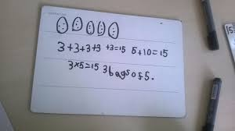


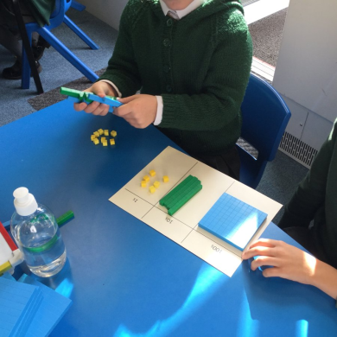
English and Maths

Slide 10
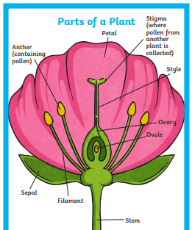



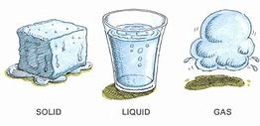
Year 3 Science

Slide 11


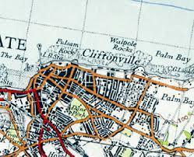
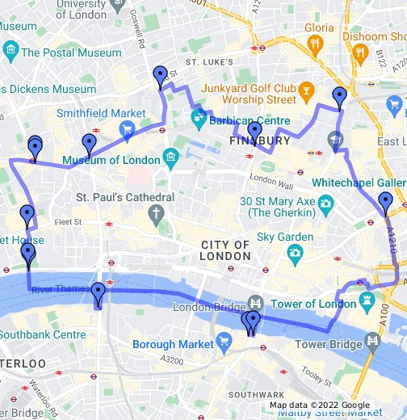
Year 3 History and Geography

Slide 12

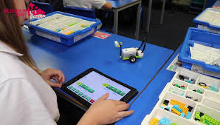
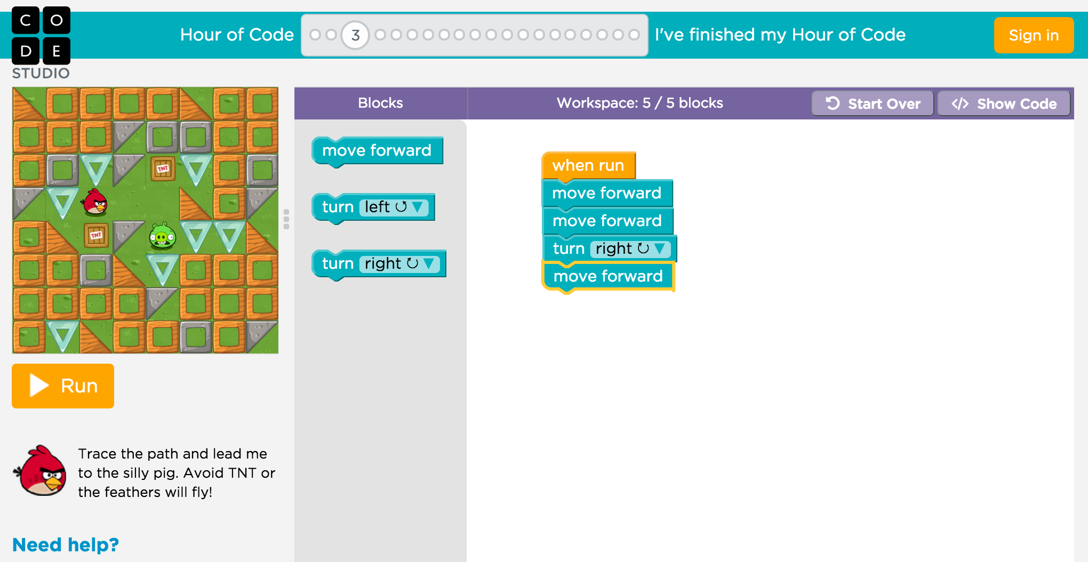
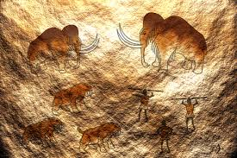

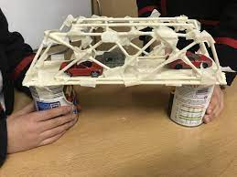

Art, DT,
ICT, French

Slide 13


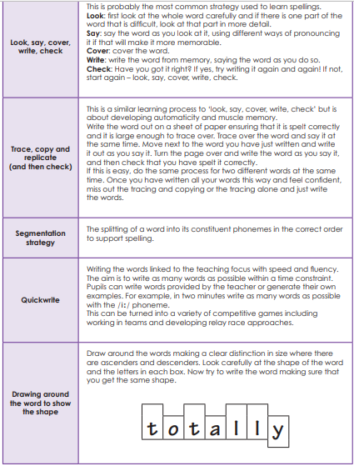
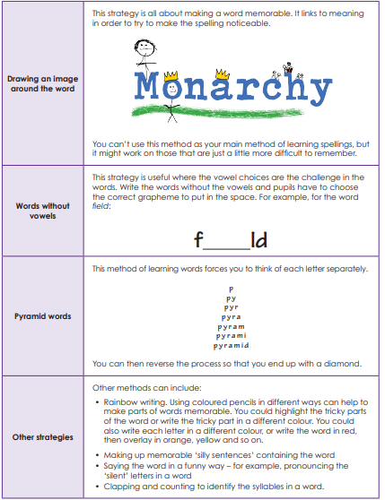
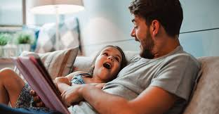
Homework
Please ensure your child completes their homework each week. If you have difficulty accessing homework online please talk to your child’s teacher.
Spelling
Maths
Reading

Slide 14
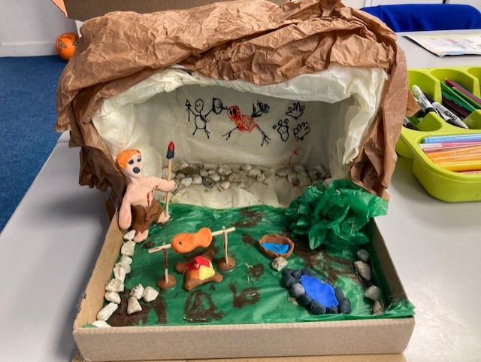
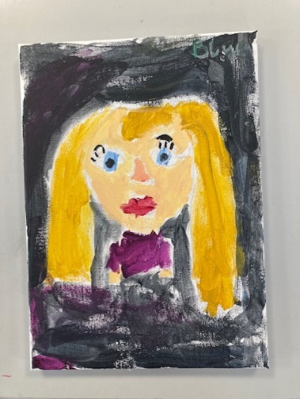
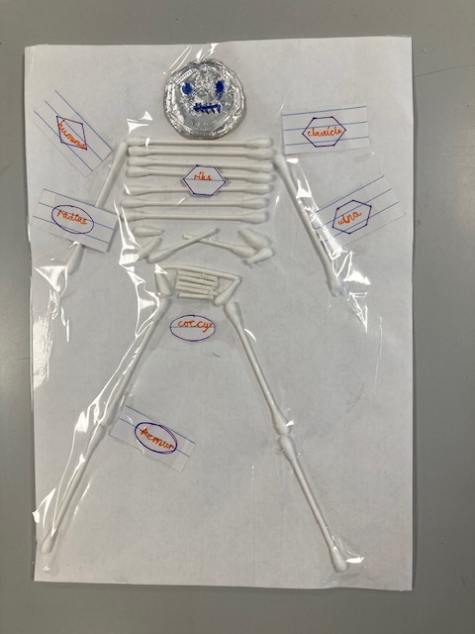
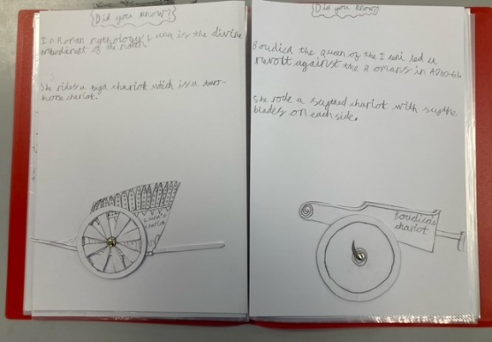
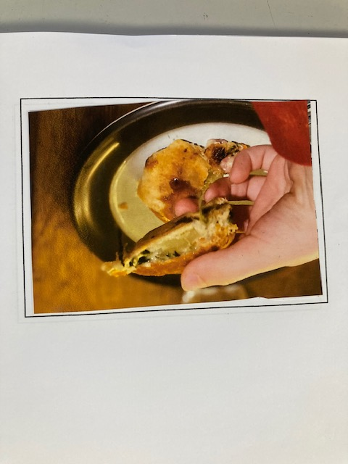
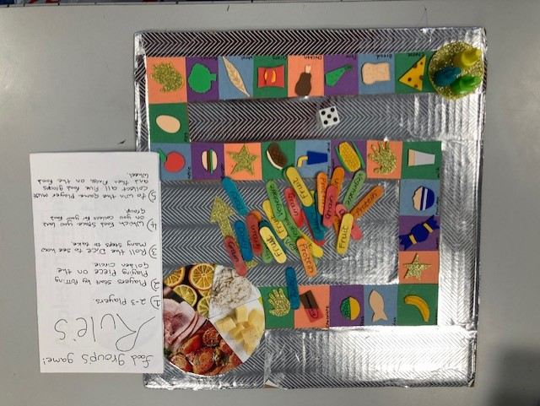
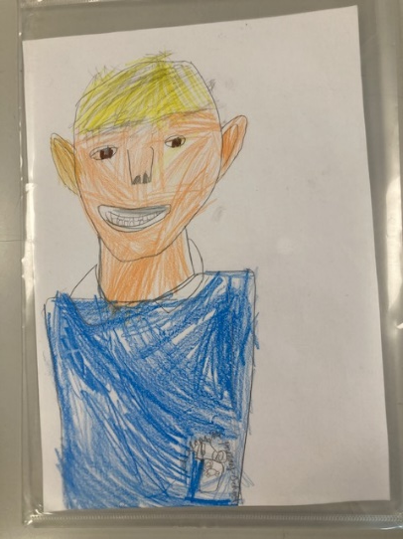
Home Learning Challenges

Slide 15
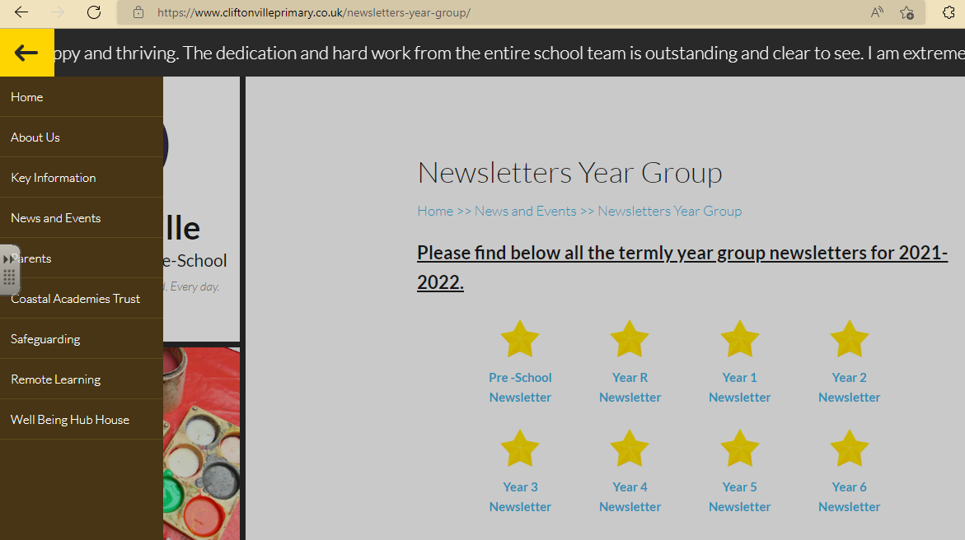


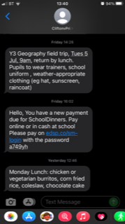
Communication
Head Teacher’s newsletter
Year group newsletter
Texts
Blog
Parents’ evening
Letters
Come and See Events
Just speak to us once the children have been collected
Home | Cliftonville Primary & Pre-School

Slide 16
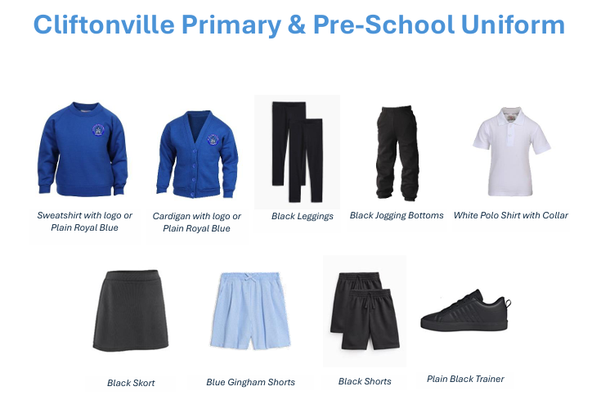
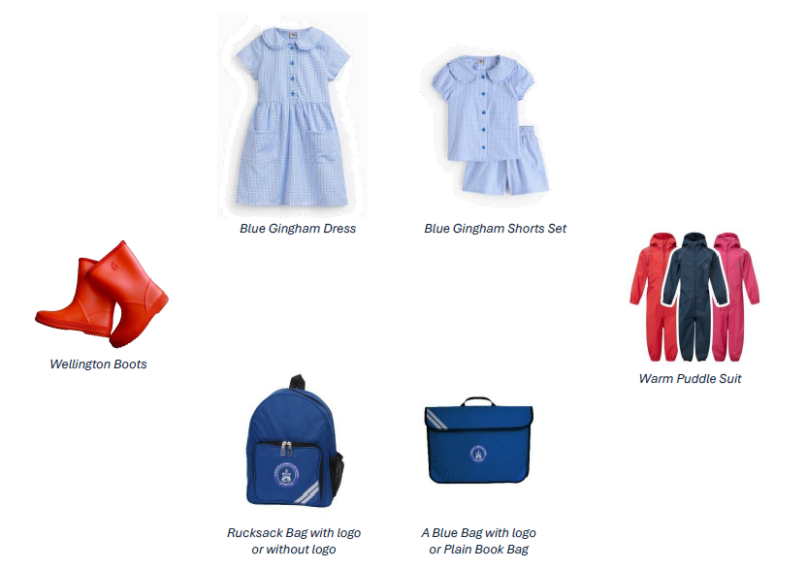

Slide 17

Please use full names and not just initials.

Slide 18
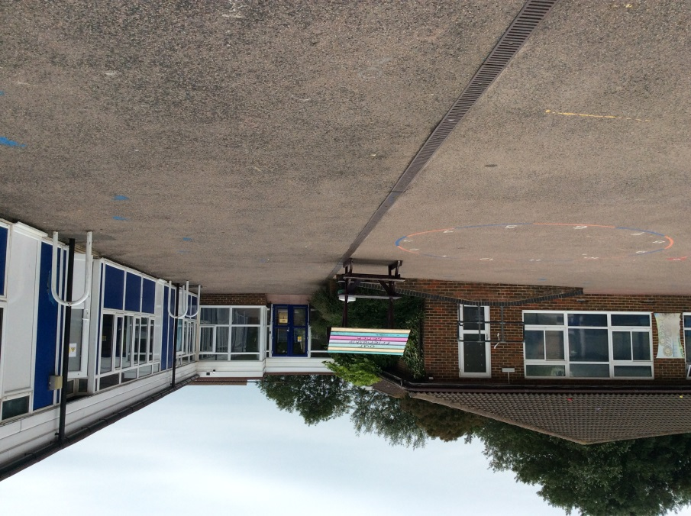
Home time 3.05
3K and 3W
3J and 3B

Slide 19


Issues
Please speak to someone from the year 3 team if you have any concerns or questions.

Slide 20
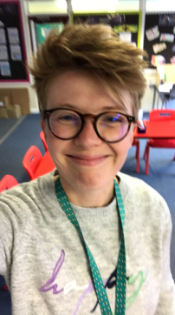
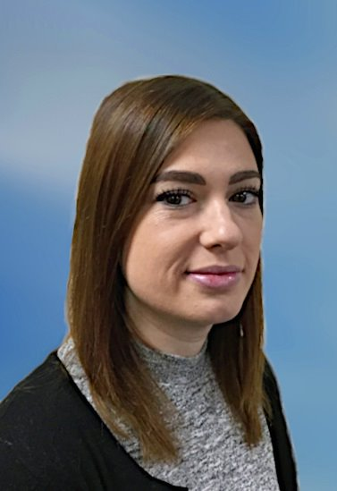
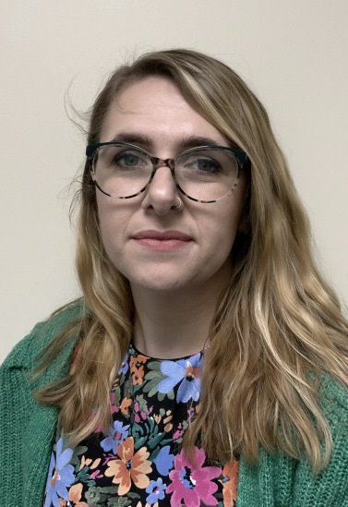
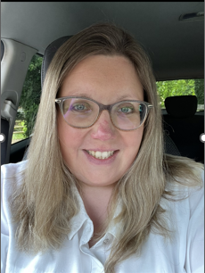
The SEND Team
Mrs Carpenter
SENDCO
Miss Avery
SEN Admin Assistant
Mrs Beech and Mrs Crowther
Assistant SENDCOs
Speak to assistant senco (KS1 and KS2 playgrounds at the start of the day)

Slide 21
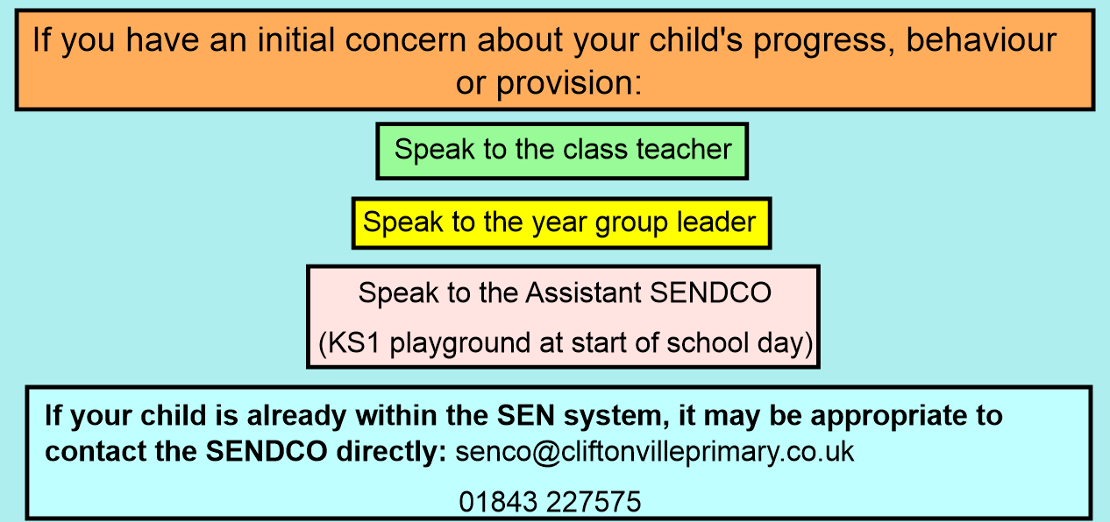

Slide 22

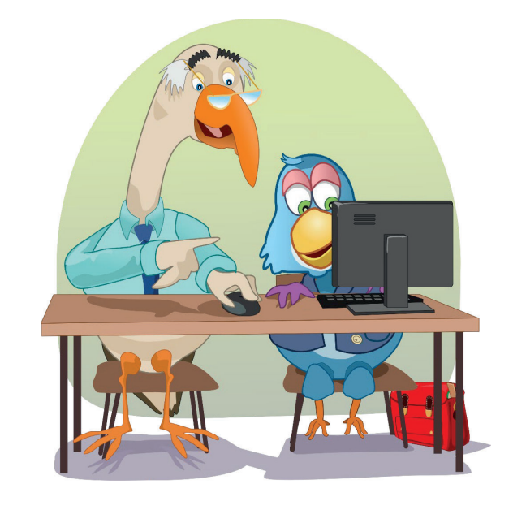
Speech and Language
Speech and Language skills are crucial for wellbeing, success, communication, and building relationships. These skills are also vital for learning, with increasing demands as children progress through education.
Difficulties in understanding language can be easily missed as children may learn to compensate, potentially leading to problems with spoken language, literacy, and behaviour.
All Year 3 children will undergo a brief, computer-based language assessment (which
they find quite fun!), to ensure appropriate support. If a need is identified, your
child will participate in a group language intervention, and you will receive a
letter. If you have any concerns about your child’s speech and language,
please speak to their class teacher initially.

Slide 23

Speech and Language UK also have lots of free resources on their website as well as a ‘progress checker’ if you have concerns about your child’s speech and language development. https://progress-checker.speechandlanguage.org.uk

Slide 24


Wednesday 2nd September 2026
Enjoy your holidays and we look forward to seeing you soon.

Slide 25

Thank you

